Slide 1

Route Prediction Algorithms using AI & its Applicability in Maritime domain
A
Internship Project Presentation
Submitted
in partial fulfillment
for the award of Degree of
Bachelor of Technology
in
Electronics and Communication Engineering
Submitted by-
Supervisor :
Dr. Deepak Bhatia
Rohit Jangid
8th Semester
Department of Electronics Engineering
Rajasthan Technical University, Kota
7th May, 2024

Slide 2
Guided by :- Smt Jalpa B. Modi Maam
(Head –SDPD/MDPG/SIPA)
Internal Guide :- Mr. Wasim Akram Sir
-Rohit jangid

Slide 3
Presentation Outline
Organisation Profile (SAC,ISRO) /
Problem Statement
AIS data, SAR Data
Literature Review (RNN, LSTM, GRU)
Transformers and Architecture
Project Work
Results
Conclusions
Future Scopes
Major
Q&A

Slide 4

Organisation Profile (SAC, ISRO)
About SAC,ISRO : -
The Space Applications Centre (SAC) is a major research center of the Indian Space Research Organisation (ISRO), located in Ahmedabad, Gujarat. Established in 1972, SAC plays a crucial role in developing and operationalizing space-based applications for various national needs, including communications, remote sensing, meteorology, and navigation. It is also actively involved in research and development activities related to spacecraft payloads, ground systems, and data processing.
About SDPD (SAR Data Processing Division) : -
The SAR Data Processing Division at SAC specializes in processing and analyzing data acquired from Synthetic Aperture Radar (SAR) sensors onboard Indian and foreign remote sensing satellites. It develops advanced algorithms and software for SAR data processing, calibration, and product generation. The division plays a crucial role in applications such as resource monitoring, disaster management, and Earth observation studies utilizing SAR technology.

Slide 5
"Ship Trajectory Prediction and Analysis through Integration of Automatic Identification System (AIS) and Synthetic Aperture Radar (SAR) Data using Transformer-Based Deep Learning Models"
Problem Statement :
Example : The maritime challenge involves six ships operating within a 50 km radius at sea. One ship acts as the master and gathers information from the others, including details like location, time, speed, direction, MMSI, IMO, and destination port. Sometimes, data collisions happen, creating challenges in figuring out the ship's path accurately. The master ship shares this information with a satellite.
Automatic Identification System (AIS) data has important information about ships, like location, time, speed, direction, MMSI, IMO, and destination port. These details are fundamental in establishing a ship's path pattern. However, there are challenges that arise due to potential collisions and instances where ship operators may intentionally provide false data for phishing or distraction purposes. To tackle these issues, Synthetic Aperture Radar (SAR) plays a crucial role. SAR, with its high-resolution radar imagery, acts as a verification tool to confirm the accuracy of AIS information.
The goal is to utilize transformer-based deep learning methods to forecast the trajectory of a specific ship, especially when the data is incomplete or impacted by collisions. This solution aims to reveal patterns in how the ships move and adjust to the changing conditions of the sea, ultimately providing precise predictions.
Using data from the past, the system learns and keeps up with how things usually happen. It also spots when something unusual occurs, like a collision. The transformers help the system handle the unexpected nature of the sea, making the predictions about ship paths more accurate.
In summary, this approach combines transformers and deep learning to handle the complexities of maritime data, providing a way to predict ship paths even in challenging situations.

Slide 6
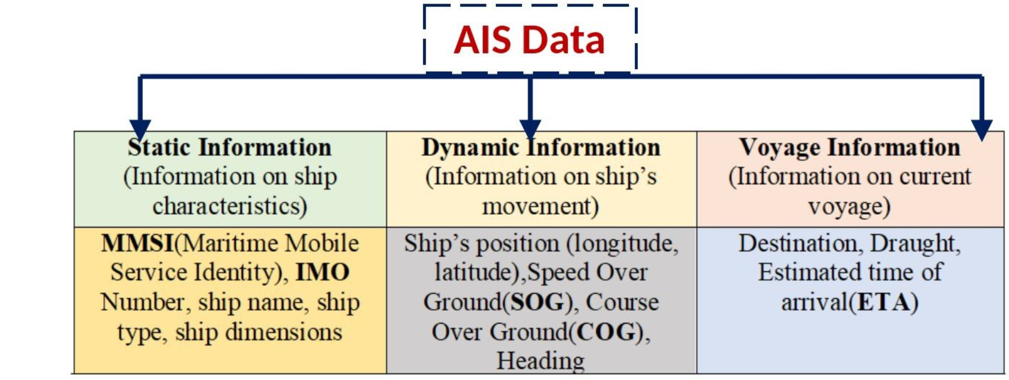
SAR Data, SAR image
SAR (Synthetic Aperture Radar) is an active remote sensing technique that uses microwave radiation to acquire high-resolution imagery of the Earth's surface. Unlike optical sensors, SAR can operate day and night, and is not affected by cloud cover or atmospheric conditions. SAR data is collected by emitting and receiving microwave pulses from an antenna mounted on a satellite or aircraft.
SAR images are created by processing the returned signals, measuring the amplitude and phase of the backscattered energy from the Earth's surface. These images provide information about the roughness, dielectric properties, and geometry of the observed targets. SAR data is particularly useful for applications such as monitoring vegetation, mapping geological features, detecting changes in urban areas, and studying ice and ocean surfaces.

Slide 7
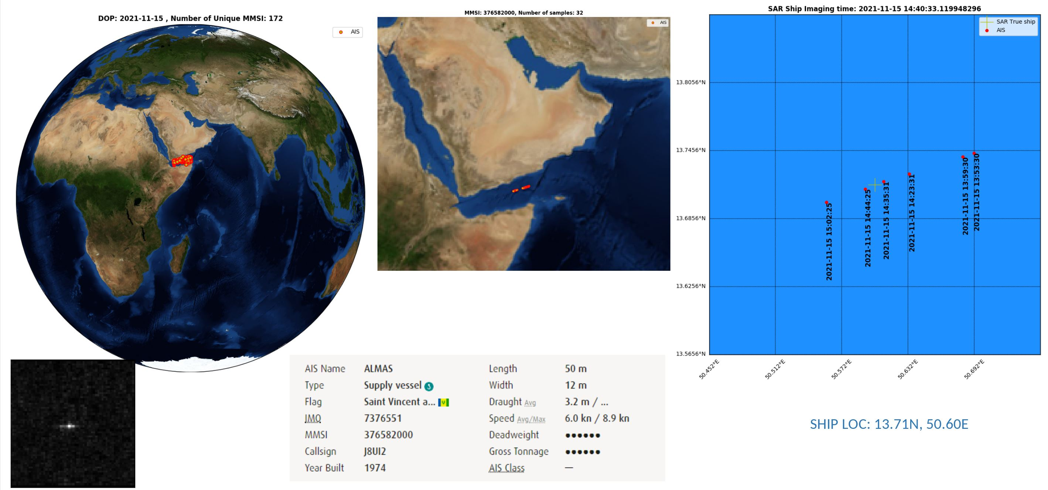

Slide 8
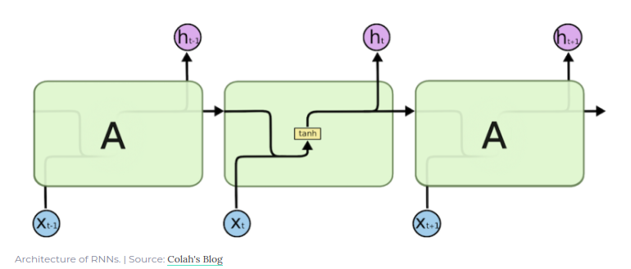
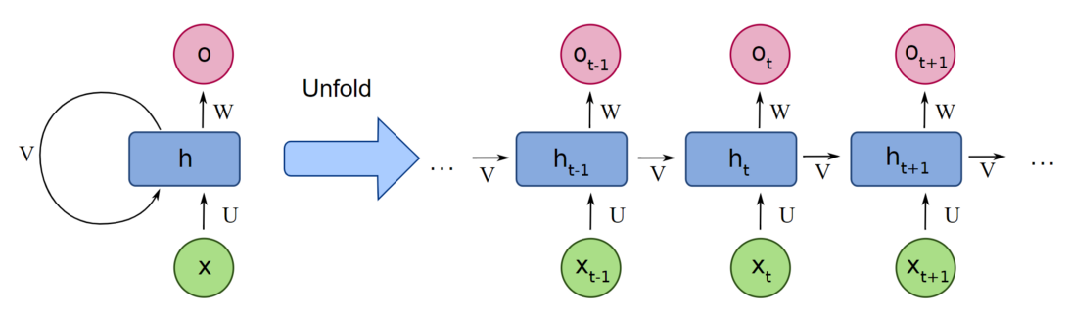
RNN ( Recurrent Neural Network )
RNNs are good at modelling sequential data such as text, audio, time series data, etc. has one input and one hidden layer and one output.
RNNs are similar to fully connected neural network with a feedback loop. Imagine output of the first step is feedback as input for next step and this enables the RNNs to have memory.
RNNs are basically the above network repeated n times for n time steps. At every time step, it can process the new information with the context of outputs of the prior steps. Though RNNs have memory but due to their inherent nature, they were not good at retaining it long enough. They suffer from short term memory.
An RNN has two major disadvantages, however:
It’s slow to train.
Long sequences lead to vanishing gradient or the problem of long-term dependencies. In simple terms, its memory is not that strong when it comes to remembering old connections.

Slide 9
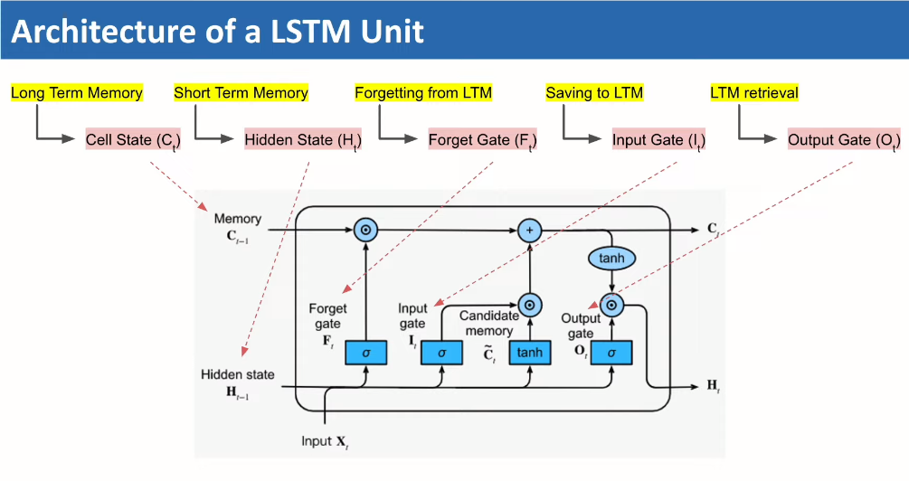
LSTMs (Long Short-Term Memory)
Long short-term memory is a special kind of RNN, specially made for solving vanishing gradient problems. They are capable of learning long-term dependencies. In fact, remembering information for long periods of time is practically their default behaviour, not something they struggle to learn!
Further, like the simple RNN, it is also very slow to train, and perhaps even slower. These systems take input sequentially one by one, which doesn’t use up GPUs very well, which are designed for parallel computation.

Slide 10
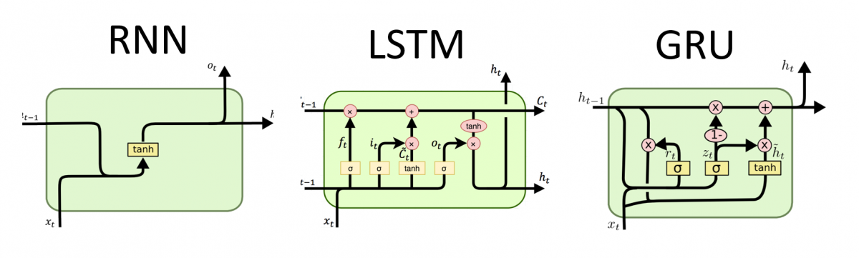
Architecture comparision

Slide 11
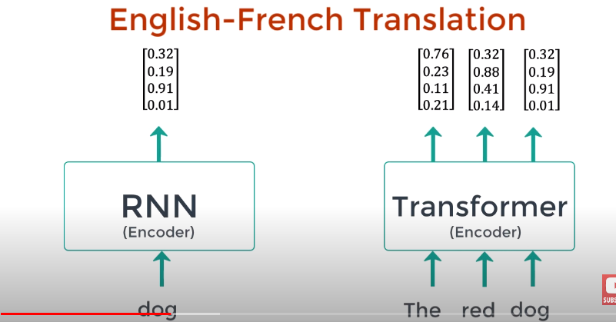

Slide 12
Why Transformer
While Recurrent Neural Networks (RNN), Long Short-Term Memory (LSTM), and Gated Recurrent Unit (GRU) models have been widely used for sequence prediction tasks, including ship trajectory prediction, transformers have emerged as a more effective alternative for several reasons:
1. Long-range dependencies: Transformers can capture long-range dependencies more effectively than RNN-based models, which are limited by vanishing gradients and exploding gradients.
2. Parallelization: Transformers can process input sequences in parallel, which allows them to handle large amounts of data more efficiently than RNN-based models.
3. Self-attention mechanism: Transformers use self-attention to determine the importance of each input element, which helps them to focus on the most relevant information for prediction.
4. Scalability: Transformers can handle larger input sequences more effectively than RNN-based models, which is crucial for ship trajectory prediction, where data can be extensive and complex.

Slide 13
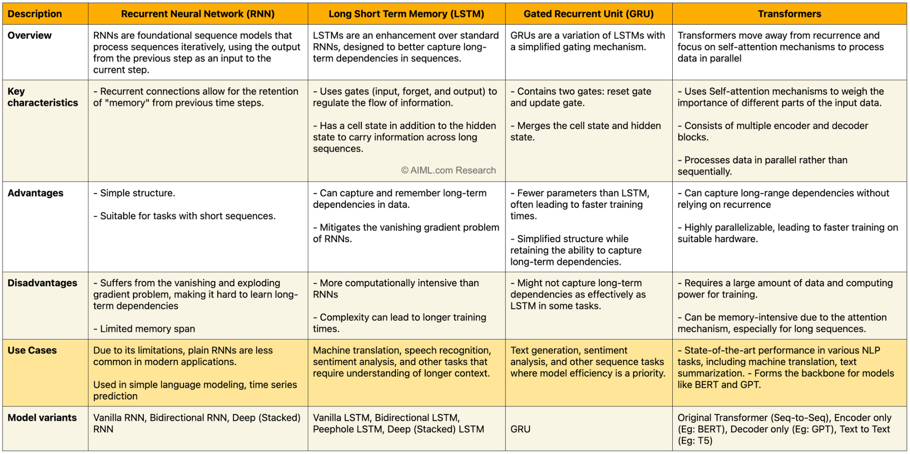

Slide 14

Transformer Architecture
Project Work
Input Embedding
Positional Encoding
Multi-Head self Attention
Add & Norm
Position-wise fully connected feed forward network
Masked multi-Head Attention
Linear and Softmax

Slide 15
Project Work
Dataset Details
1. Work on CT_DMA dataset On TrAISformer model
2. Work on ResourceSAT-2 dataset On TrAISformer model
Work on CT_DMA dataset On TrAISformer model (Danish Maritime Authority datasets)
The TrAISformer project uses a dataset of Automatic Identification System (AIS) trajectories from vessels. The dataset consists of a list of dictionaries, where each dictionary represents a single vessel's trajectory. The trajectories are stored in pickle files, which are loaded during the data pre-processing step.
Each dictionary in the dataset contains the following keys: 1."mmsi" The Maritime Mobile Service Identity MMSI number, which is a unique identifier
for the vessel. 2."traj" A numpy array representing the vessel's trajectory. Each row of the “traj” array corresponds to a specific time step and contains the following columns:
Latitude (normalized to the range [0, 1])
Longitude (normalized to the range [0, 1])
Speed Over Ground (SOG) (normalized to the range [0, 1])
Course Over Ground (COG) (normalized to the range [0, 1])
UNIX timestamp

Slide 16
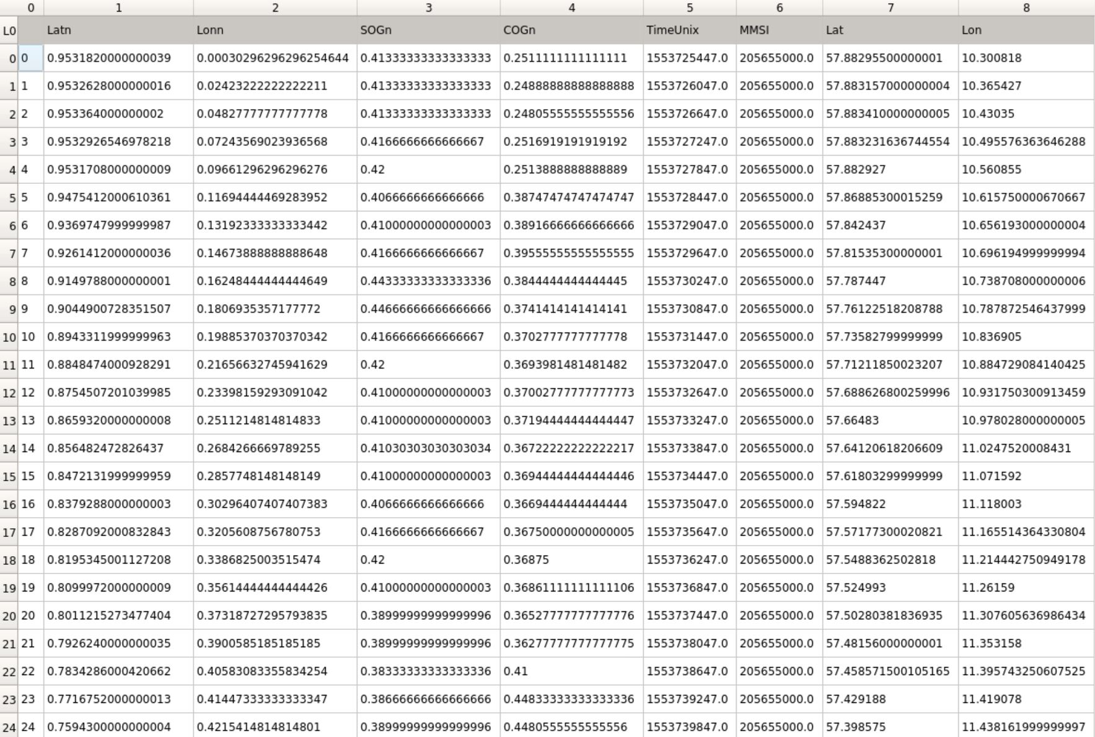
CSV – MMSI 205655000

Slide 17
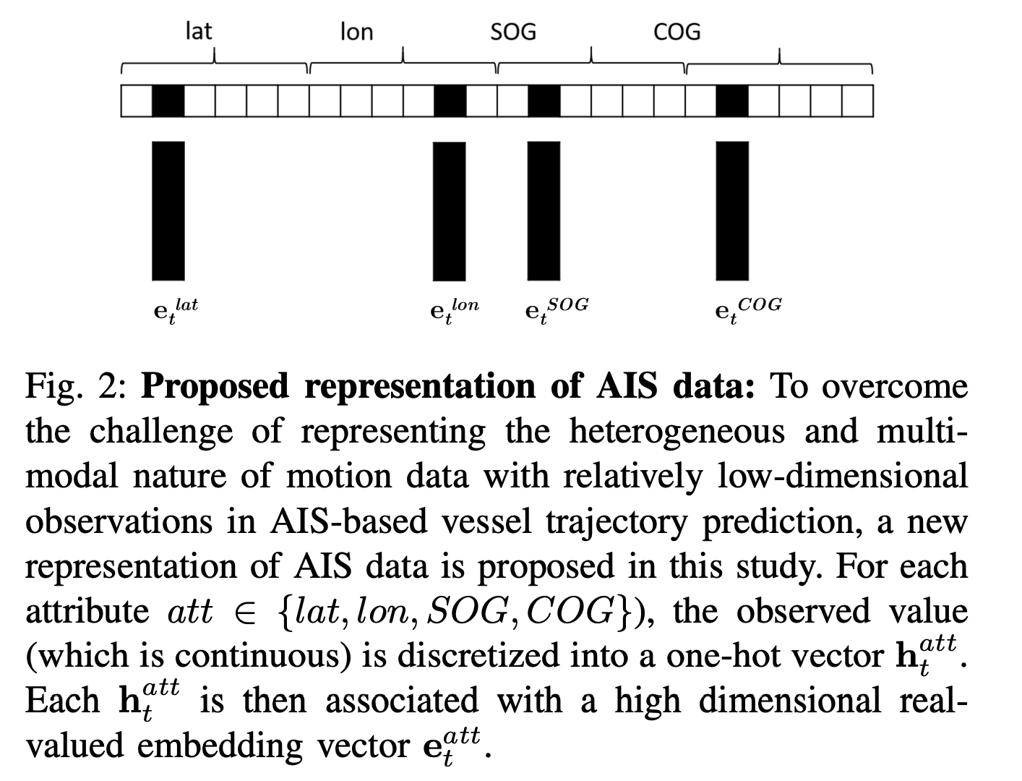
‘MMSI’ | ‘Traj’
MMSI_VALUE | LATn, LONn, SOGn, COGn, TIMEUNIX,MMSI
123456789 | np.array[[0.15545 0.564156 0.54154 0.25486 1648828800 123456789]]
Input Data for Model →

Slide 18
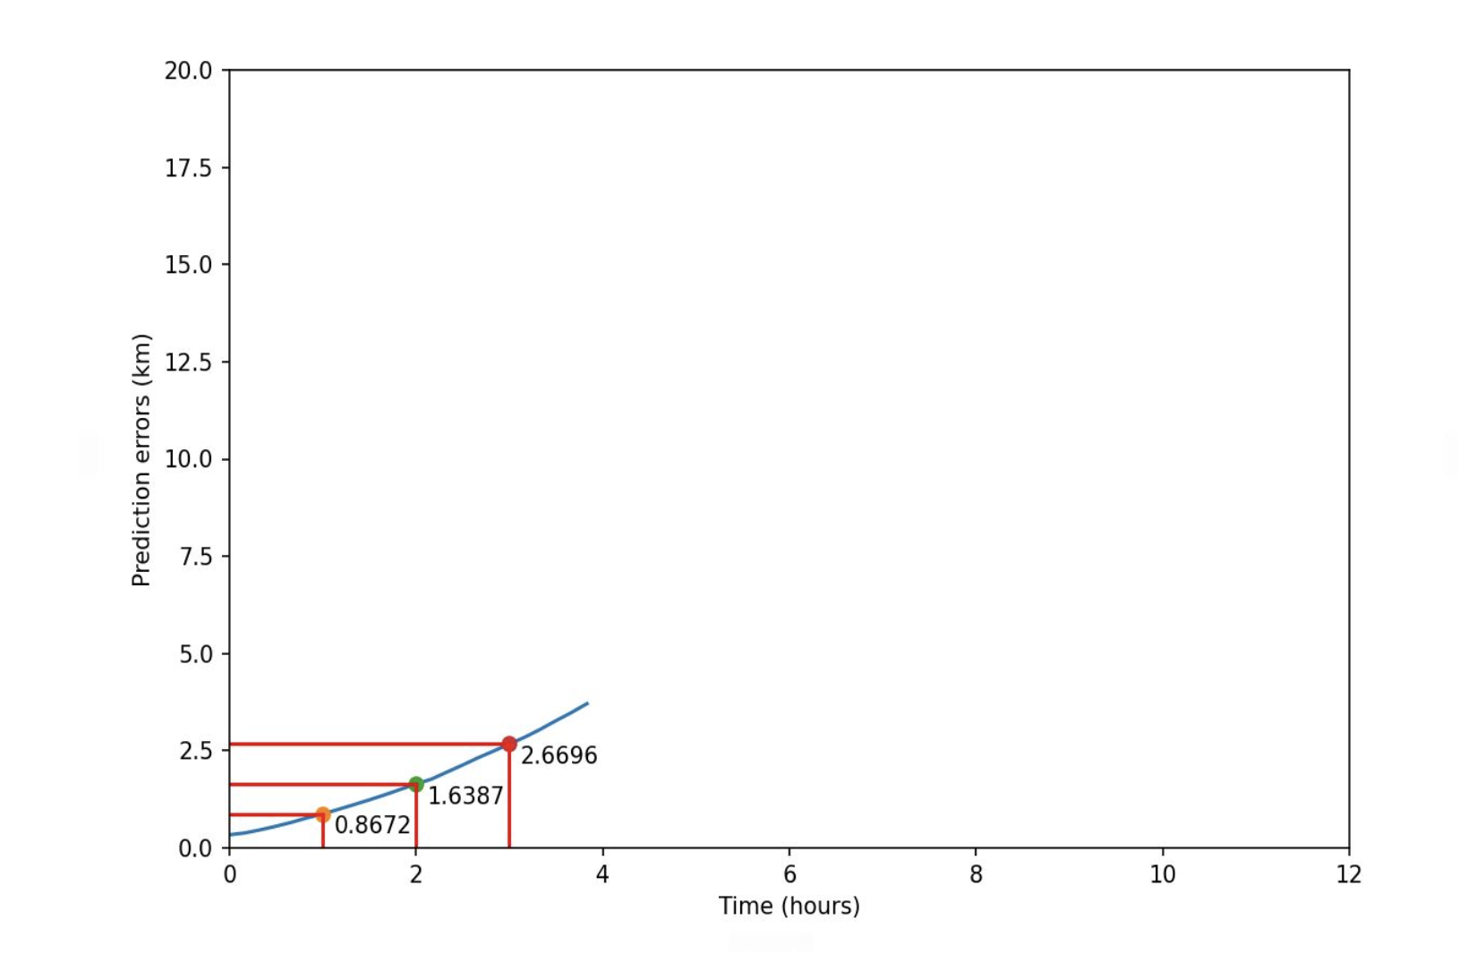
Results Form CT_DMA

Slide 19
2. Work on ResourceSAT-2 dataset On TrAISformer model
Data Pre-processing :
Load the AIS dataset from the provided pickle files.
Filter out the trajectories with missing or NaN values, as well as trajectories that are too
short.
Normalize the latitude, longitude, speed over ground (SOG), and course over ground
(COG) features to the range [0, 1].
Split the dataset into training, validation, and test sets.
Create PyTorch datasets and data loaders for efficient data handling during training and
evaluation.

Slide 20
2. Work on ResourceSAT-2 dataset On TrAISformer model
Linear Interpolation:
Assumes a constant rate of change between known points.
Simple and computationally efficient, but inaccurate for larger gaps or complex maneuvers.
Cubic Spline Interpolation:
Creates a smooth curve passing through all known points.
Generally more accurate than linear, but computationally expensive and may overfit.
Kinematic Interpolation:
Incorporates additional data like speed, course, and rate of turn.
Useful for understanding ship behavior, but requires more data points.
Kalman Filtering:
Statistical technique to estimate state from noisy measurements.
Handles uncertainties well, but requires parameter tuning and is computationally intensive.
Piecewise Cubic Hermite Interpolation (PCHI):
Constructs a smooth curve while preserving specified derivatives at data points.
Useful for interpolating trajectories based on latitude, longitude, SOG, and COG.

Slide 21
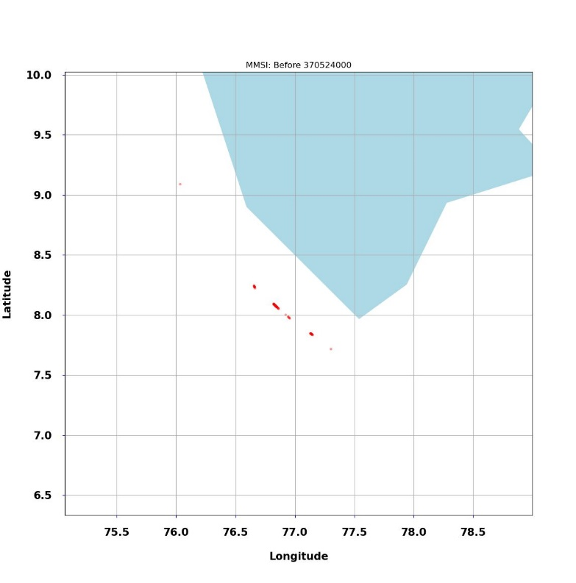
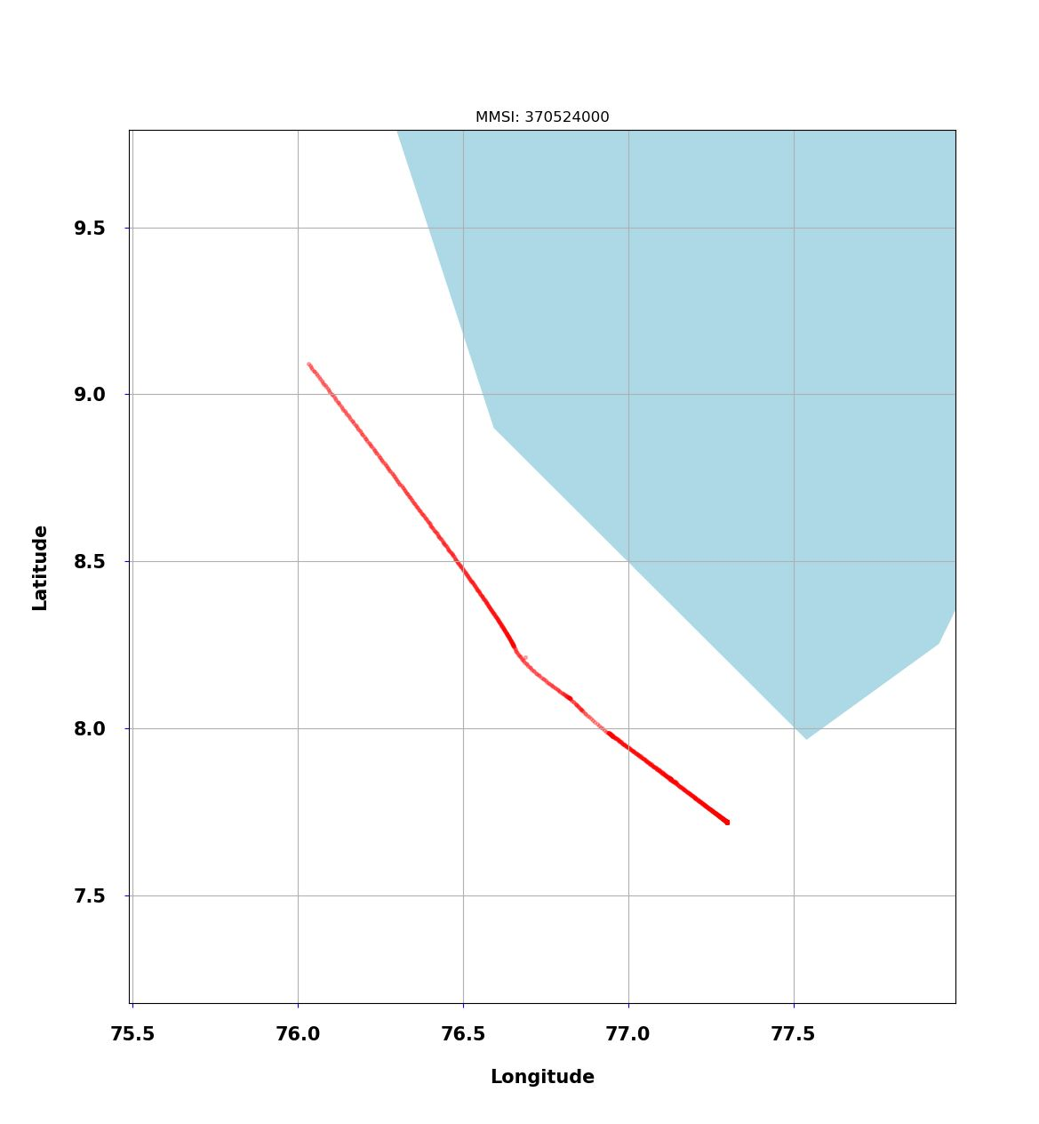
Data Pre-processing Results
Before Interpolation
After Interpolation

Slide 22
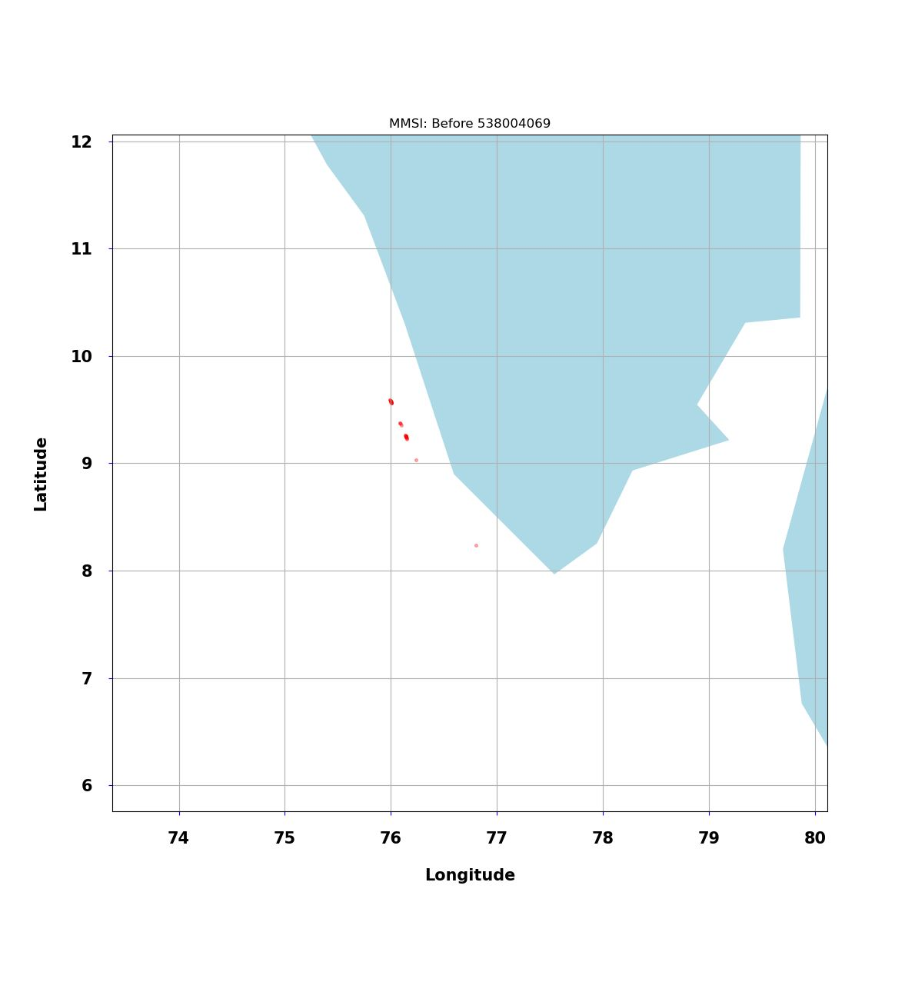
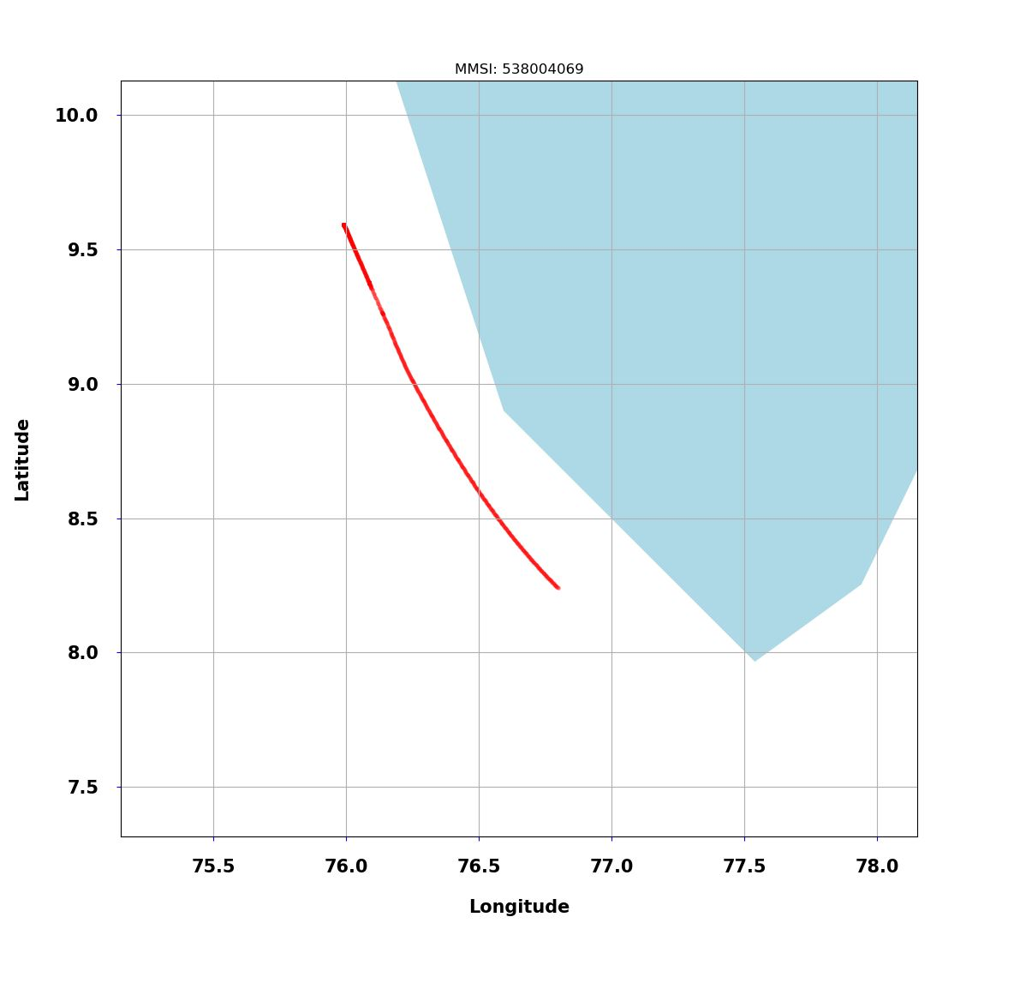
Data Pre-processing Results
Before Interpolation
After Interpolation

Slide 23
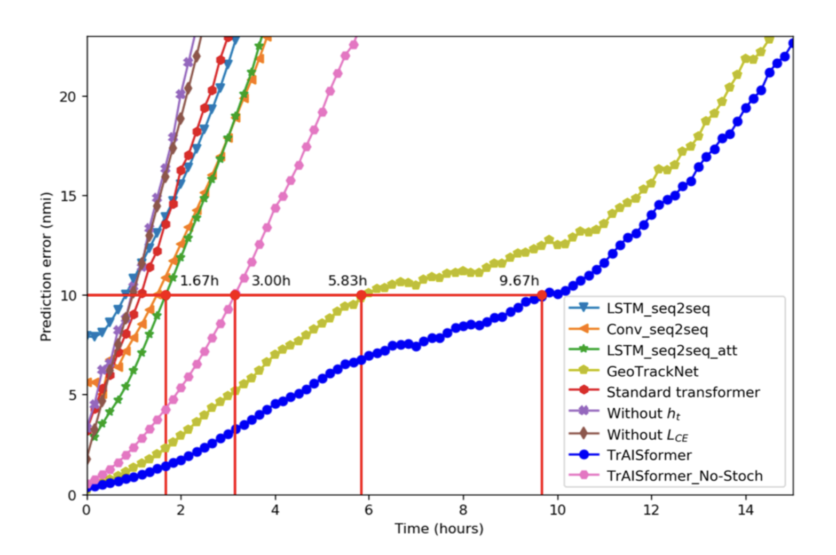
Prediction Error from different Model

Slide 24
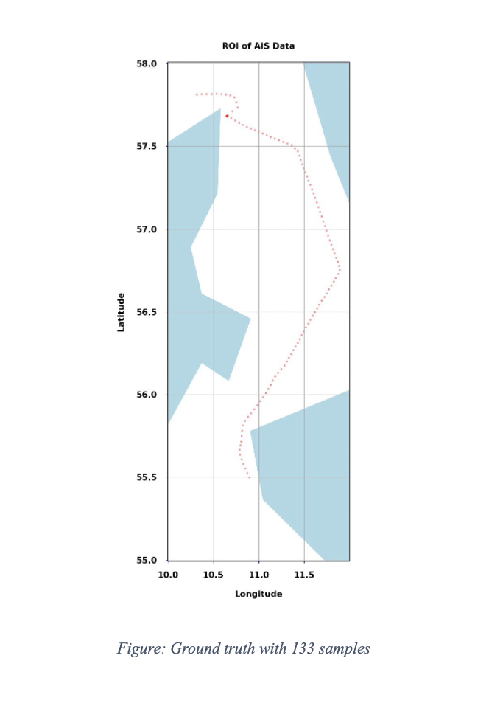
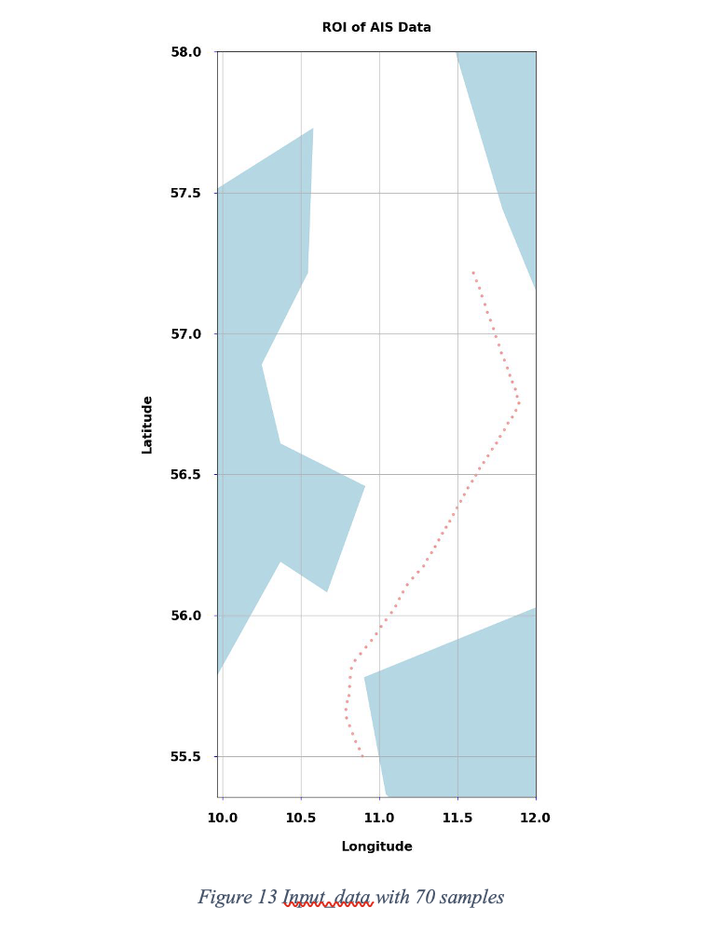
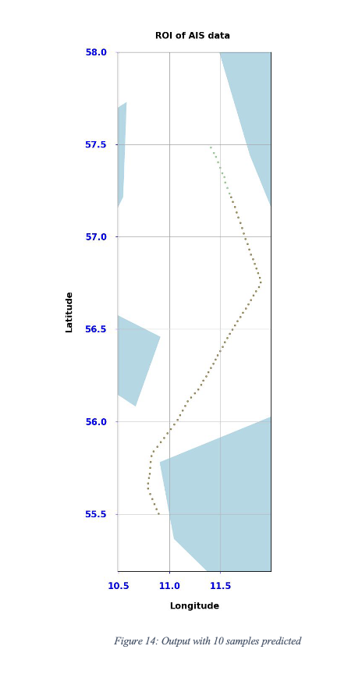
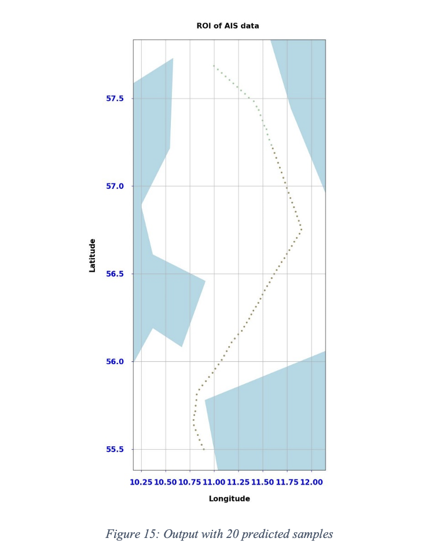
Results

Slide 25
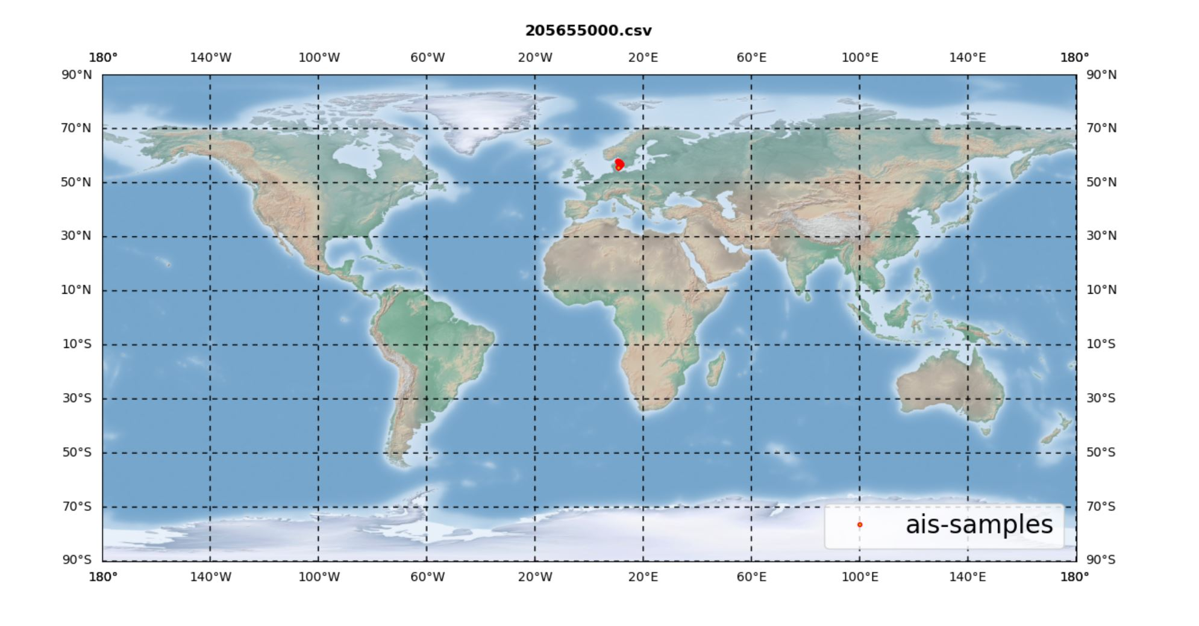

Slide 26
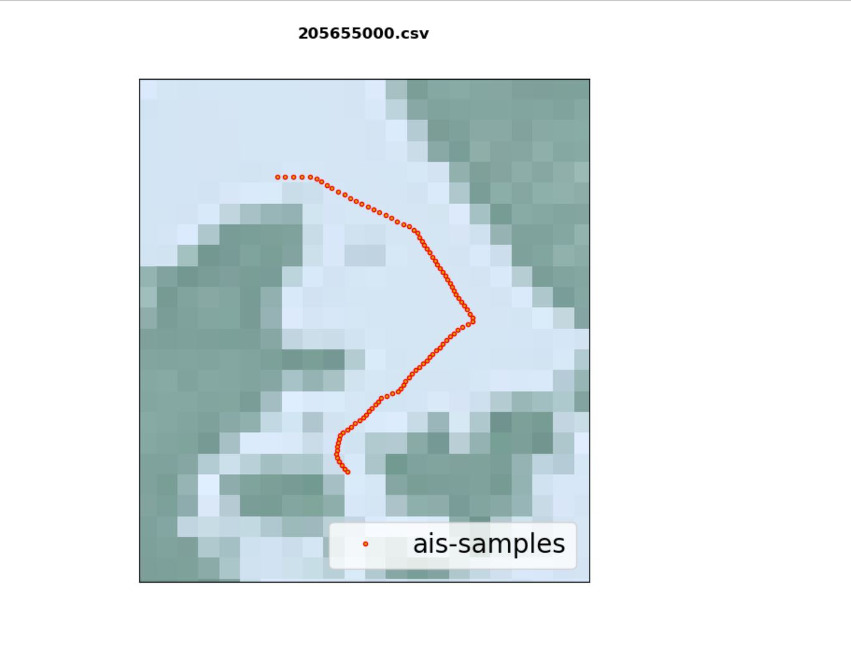
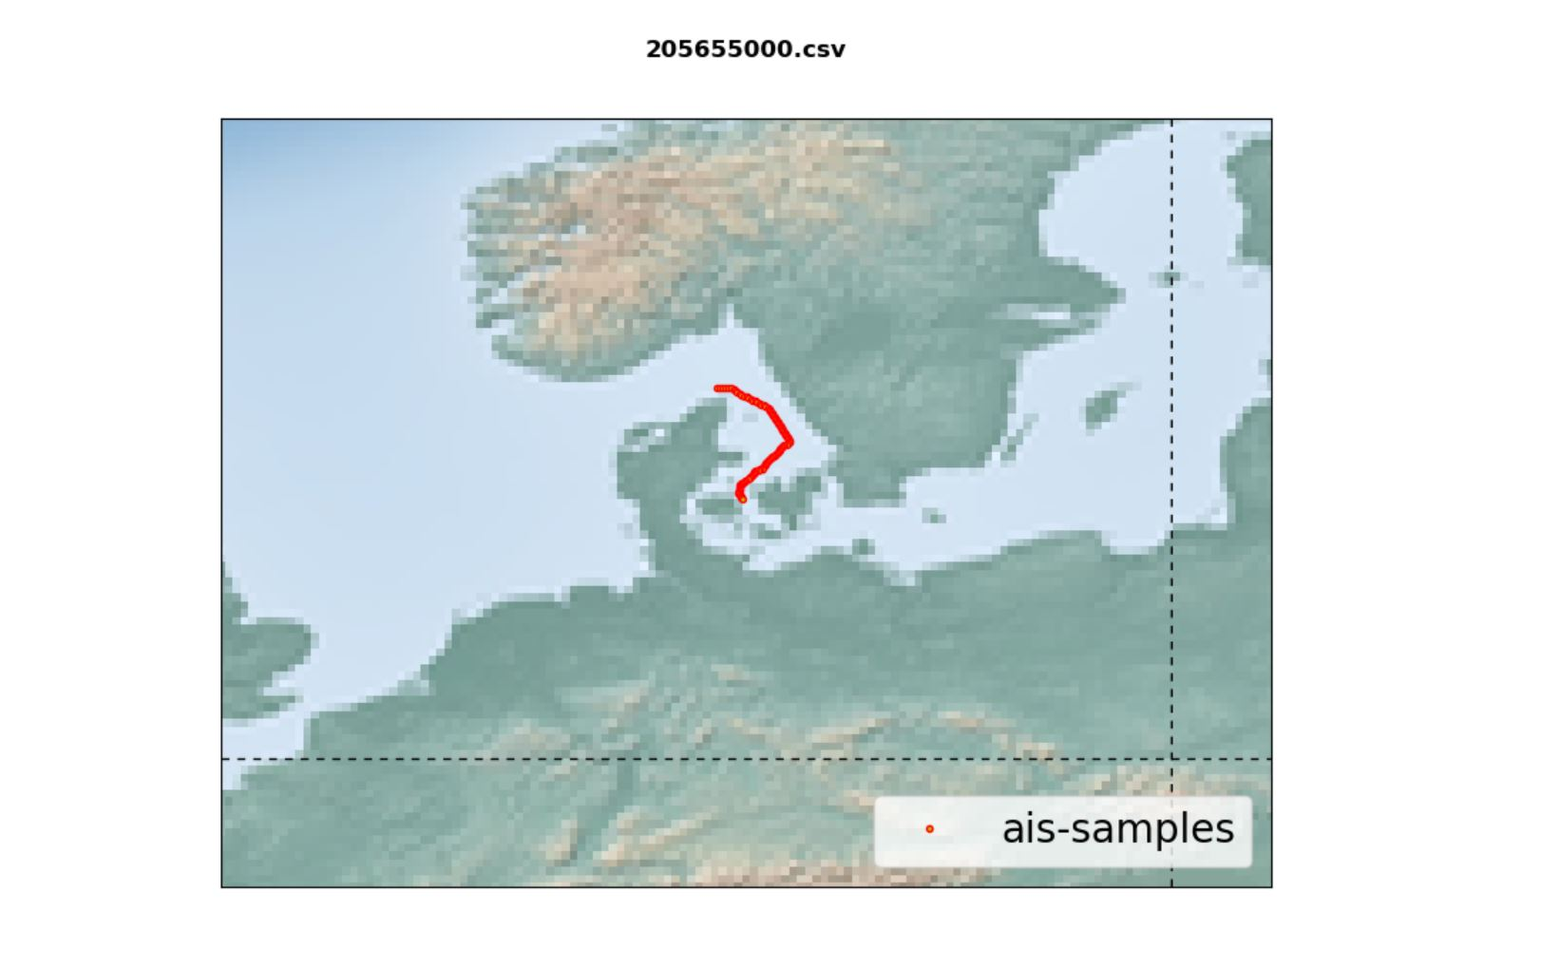

Slide 27
Conclusion
The monitoring of ship routes is crucial for maritime surveillance, typically done using spaceborne AIS (Automatic Identification System) data. However, AIS data often contains corruptions and missing points, necessitating route prediction techniques. In this project, a transformer-based model called "TrAISformer" was studied and evaluated using Danish Maritime Authority datasets, yielding expected results.
Subsequently, the TrAISformer model was applied to AIS data obtained from ISRO's ResourceSat-2 satellite, focused on the Indian region. Extensive preprocessing, including outlier removal, inconsistency handling, and various interpolation techniques (PCHIP, Akima, Cubic), was performed to address missing data points. The PCHIP interpolation method proved most accurate for reconstructing ship trajectories in the Indian region.
Through experimentation and evaluation, the TrAISformer model demonstrated its effectiveness in generating accurate and realistic ship trajectory predictions tailored to the unique characteristics of Indian maritime traffic. Its ability to handle variable-length sequences and flexible architecture make it a valuable tool for AIS-based applications within the Indian region.
Overall, the TrAISformer project represents a significant advancement in AIS-based trajectory prediction for the Indian region, leveraging transformer models and ResourceSat-2A data. It can contribute to optimizing maritime operations, enhancing safety in Indian waters, and advancing research in the Indian maritime domain.

Slide 28
Future Scopes
1. Fine-tuning and Optimization: Explore techniques to enhance the transformer model's performance for maritime applications.
2. Integration with Other Data Sources: Investigate combining AIS data with weather, oceanographic, or satellite imagery for richer context.
3. Handling Sparse and Noisy Data: Develop strategies to handle sparsity and noise in AIS data for improved predictions.
4. Long-Term Prediction: Extend the prediction horizon beyond the current 9-hour window for longer-term forecasting.
5. Adaptation to Dynamic Environments: Enhance the model's ability to adapt to evolving maritime environments through continual learning.
6. Application-Specific Extensions: Tailor the model architecture and training objectives for specific maritime applications like route optimization or collision avoidance.
7. Scalability and Deployment: Investigate methods for scaling up the model, ensuring computational efficiency and seamless integration with existing maritime systems.

Slide 29
Major
Implemented an innovative deep learning solution based on the Transformer model to accurately predict maritime vessel trajectories from incomplete or unreliable Automatic Identification System (AIS) data, ensuring enhanced navigation safety and efficiency.
Engineered a custom algorithm leveraging PCHIP that improved the quality of AIS data from ResourceSAT-2 satellite by 30% compared to previous methods, enabling effective handling of missing or corrupted data points in the Indian region.
Contributed to the integration of the developed solution into existing maritime monitoring systems, improving navigation safety and efficiency in Indian waters.
Collaborated with a cross-functional team, leveraging expertise in deep learning, data processing, and maritime operations.
Developed and implemented an application to visualize and analyse integrated AIS and SAR data, facilitating efficient decision-making for
maritime navigation and security stakeholders.

Slide 30
Questions & Answers

Slide 31
Thank you

